Slide 1


Introduction to Intrusion Detection Systems
Intrusion detection systems (IDS) are a critical component of modern cybersecurity. An intrusion detection system (IDS) is an application that monitors network traffic and searches for suspicious or malicious activity. The IDS sends alerts to IT and security teams when it detects any security risks and threats.

Slide 2
Working of Intrusion Detection System(IDS)
An IDS (Intrusion Detection System) monitors the traffic on a computer network to detect any suspicious activity.
It analyses the data flowing through the network and searches for patterns and signs of abnormal behaviour.
The IDS compares the network activity to a set of predefined rules and patterns to identify any activity that might indicate an attack or intrusion.
If the IDS detects something that matches one of these rules or patterns, it sends an alert to the system administrator.
The system administrator can then investigate the alert and take action to prevent any damage or further intrusion.

Slide 3
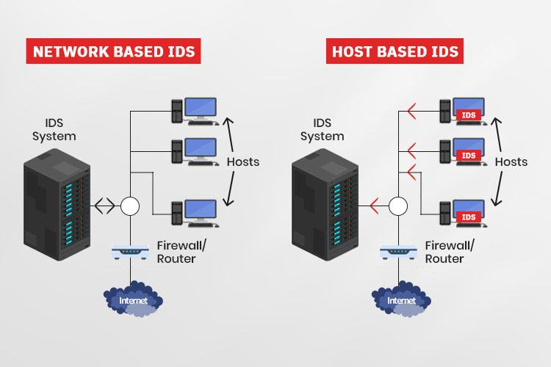
Types of Intrusion Detection Systems
1
Network-based IDS
Network-based IDS monitors the network traffic and detects potential threats. It generates an alert to notify administrators. then the administrators or other security tools takes the further step, such as blocking malicious traffic or isolating affected network segments.
2
Host-based IDS
Host-based IDS monitor individual systems for malicious activity. HIDS focuses on internal attacks by monitoring host activities instead of overall network traffic.

Slide 4




Detection Methods Of IDS
1. Signature-based Detection
Signature Generation
Signature-based IDS detects the attacks on the basis of the specific patterns such as the number of bytes.
Traffic Analysis
IDS analyze incoming traffic for matches against known signatures.
Alert Generation
If a match is found, the IDS triggers an alert, notifying security personnel.

Slide 5

2. Anomaly-based Detection
Definition:
Deviation Detection :
Anomaly-based IDS was introduced to detect unknown malware attacks as new malware is developed rapidly.
In anomaly-based IDS there is the use of machine learning to create a trustful activity model and anything coming is compared with that model and it is declared suspicious if it is not found in the model.

Slide 6
Advantages
Early Threat Detection: IDS identifies potential threats early, allowing for quicker response to prevent damage.
Enhanced Security: It adds an extra layer of security, complementing other cybersecurity measures to provide comprehensive protection.
Network Monitoring: Continuously monitors network traffic for unusual activities, ensuring constant vigilance.
Detailed Alerts: Provides detailed alerts and logs about suspicious activities, helping IT teams investigate and respond effectively.

Slide 7
Disadvantages
False Alarms: IDS can generate false positives, alerting on harmless activities and causing unnecessary concern.
Resource Intensive: It can use a lot of system resources, potentially slowing down network performance.
Requires Maintenance: Regular updates and tuning are needed to keep the IDS effective, which can be time-consuming.
Doesn’t Prevent Attacks: IDS detects and alerts but doesn’t stop attacks, so additional measures are still needed.

Slide 8




Conclusion and Future Trends
Cloud-based IDS
Cloud-based IDS offer scalability, flexibility,
and cost-effectiveness.
Machine Learning
Machine learning algorithms are being used
to improve IDS performance.
Automation and Orchestration
Automation is increasing the efficiency of IDS
management and response.

Slide 9
class AlertLog:
def _init_(self, alert_id, network_id, description):
self.alert_id = alert_id
self.network_id = network_id
self.description = description
class AlertLogManager:
def _init_(self):
self.alerts = {}
self.next_alert_id = 1
def create_alert(self, network_id, description):
alert_id = self.next_alert_id
self.alerts[alert_id] = AlertLog(alert_id, network_id, description)
self.next_alert_id += 1
return alert_id
def read_alert(self, alert_id):
return self.alerts.get(alert_id)
def update_alert(self, alert_id, network_id=None, description=None):
if alert_id in self.alerts:
if network_id:
self.alerts[alert_id].network_id = network_id
if description:
self.alerts[alert_id].description = description
return True
return False
def delete_alert(self, alert_id):
if alert_id in self.alerts:
del self.alerts[alert_id]
return True
return False
class IntrusionDetector:
def _init_(self, alert_manager):
self.alert_manager = alert_manager
def detect_network_intrusions(self, network_id):
#Simulate intrusion detection logic
if network_id % 2 ==0: #Examplecondition
alert_id = self.alert_manager.create_alert(network_id, "Suspiciousactivity detected.")
return alert_id
return None

Slide 10
def log_security_alerts(self, alert_id):
alert = self.alert_manager.read_alert(alert_id)
if alert:
print(f"Alert ID {alert.alert_id}: {alert.description} on Network{alert.network_id}")
else:
print("Alert not found.")
###2.Unit Testing using unittest
import unittest
class TestAlertLogManager(unittest.TestCase):
def setUp(self):
self.manager = AlertLogManager()
def test_alert_crud_operations(self):
#Test Create
alert_id1 = self.manager.create_alert(1, "Test Alert 1")
self.assertIsNotNone(self.manager.read_alert(alert_id1))
#Test Read
alert = self.manager.read_alert(alert_id1)
self.assertEqual(alert.description, "Test Alert 1")
#Test Update
self.assertTrue(self.manager.update_alert(alert_id1,description="Updated Alert 1"))
self.assertEqual(self.manager.read_alert(alert_id1).description,"Updated Alert 1")
#Test Delete
self.assertTrue(self.manager.delete_alert(alert_id1))
self.assertIsNone(self.manager.read_alert(alert_id1))
class TestIntrusionDetector(unittest.TestCase):
def setUp(self):
self.manager = AlertLogManager()
self.detector = IntrusionDetector(self.manager)

Slide 11
def test_detection_and_logging(self):
network_id = 2 #Shouldtrigger an alert
alert_id = self.detector.detect_network_intrusions(network_id)
self.assertIsNotNone(alert_id)
self.assertIsNotNone(self.manager.read_alert(alert_id))
self.detector.log_security_alerts(alert_id)
if __name__ == "_main_":
unittest.main()

Slide 12
D:\C++\.vscode\project.ipynb

